Slide 1
Spanish
A Language Tour
~500M
#2
21
native speakers
by native speakers
official countries
"El español no es una lengua europea. Es una lengua americana."

Slide 2
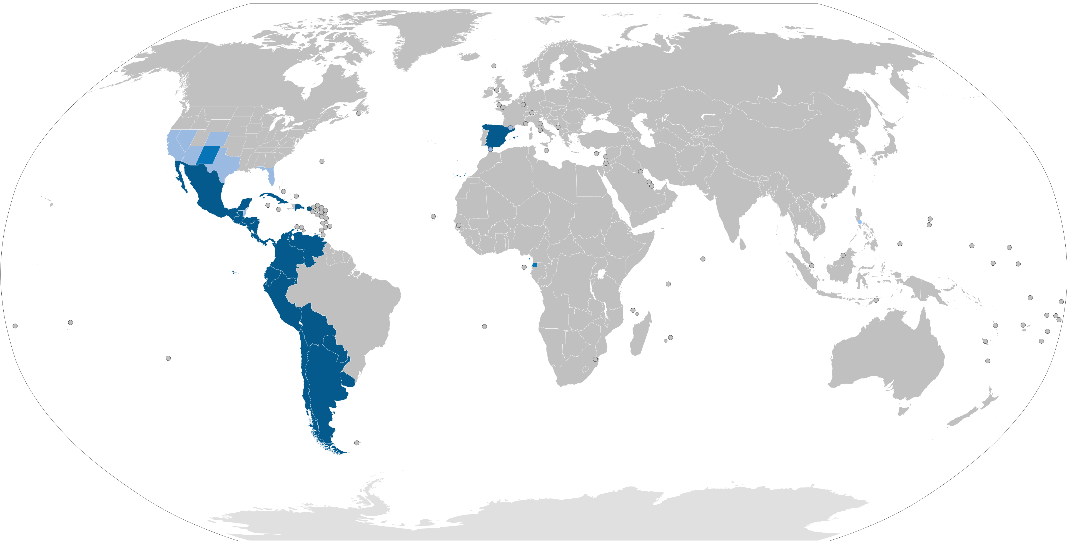
Spanish across the globe

Slide 3
La Familia Romance
Latin AQUA across the Romance family:
AQUA
agua
acqua
água
eau
Latin
Spanish
Italian
Portuguese
French
🇫🇷 French drifted so far it's barely recognisable — but it's the same word.

Slide 4
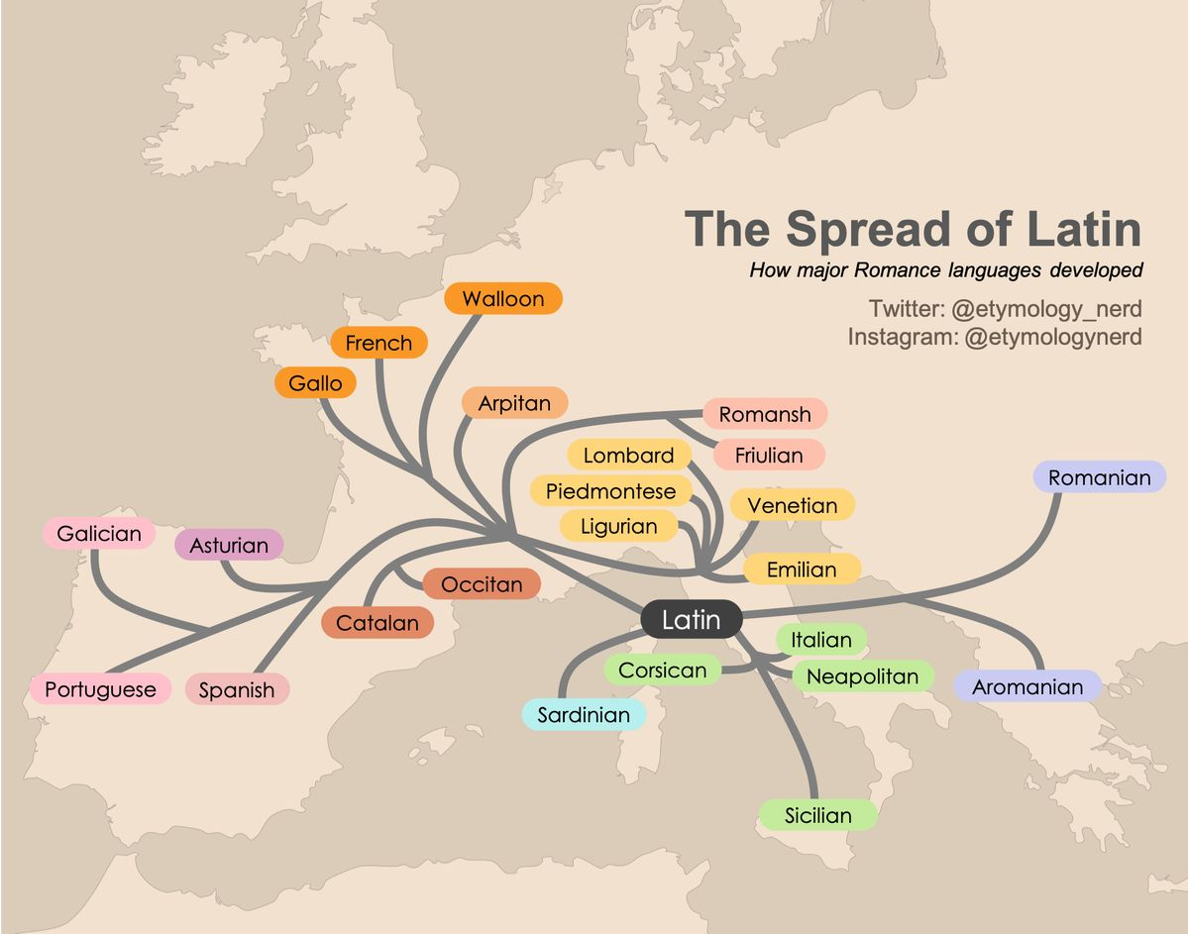
La Familia Romance

Slide 5
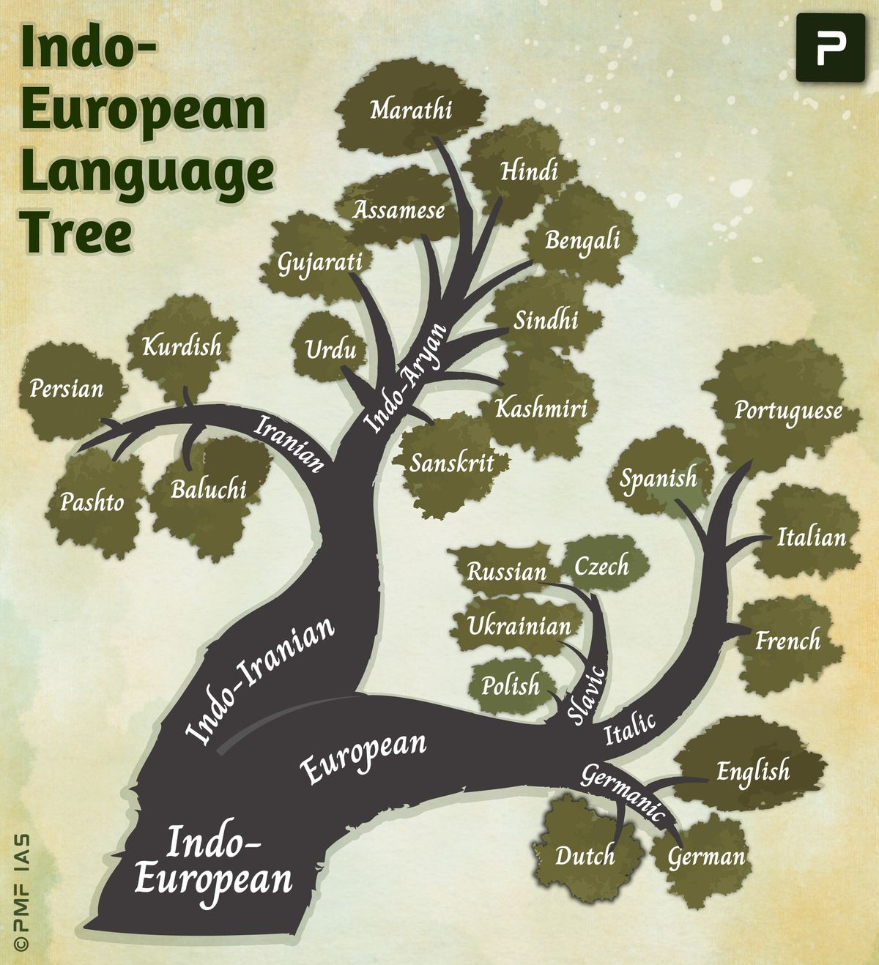
La Familia Indoeuropea

Slide 6
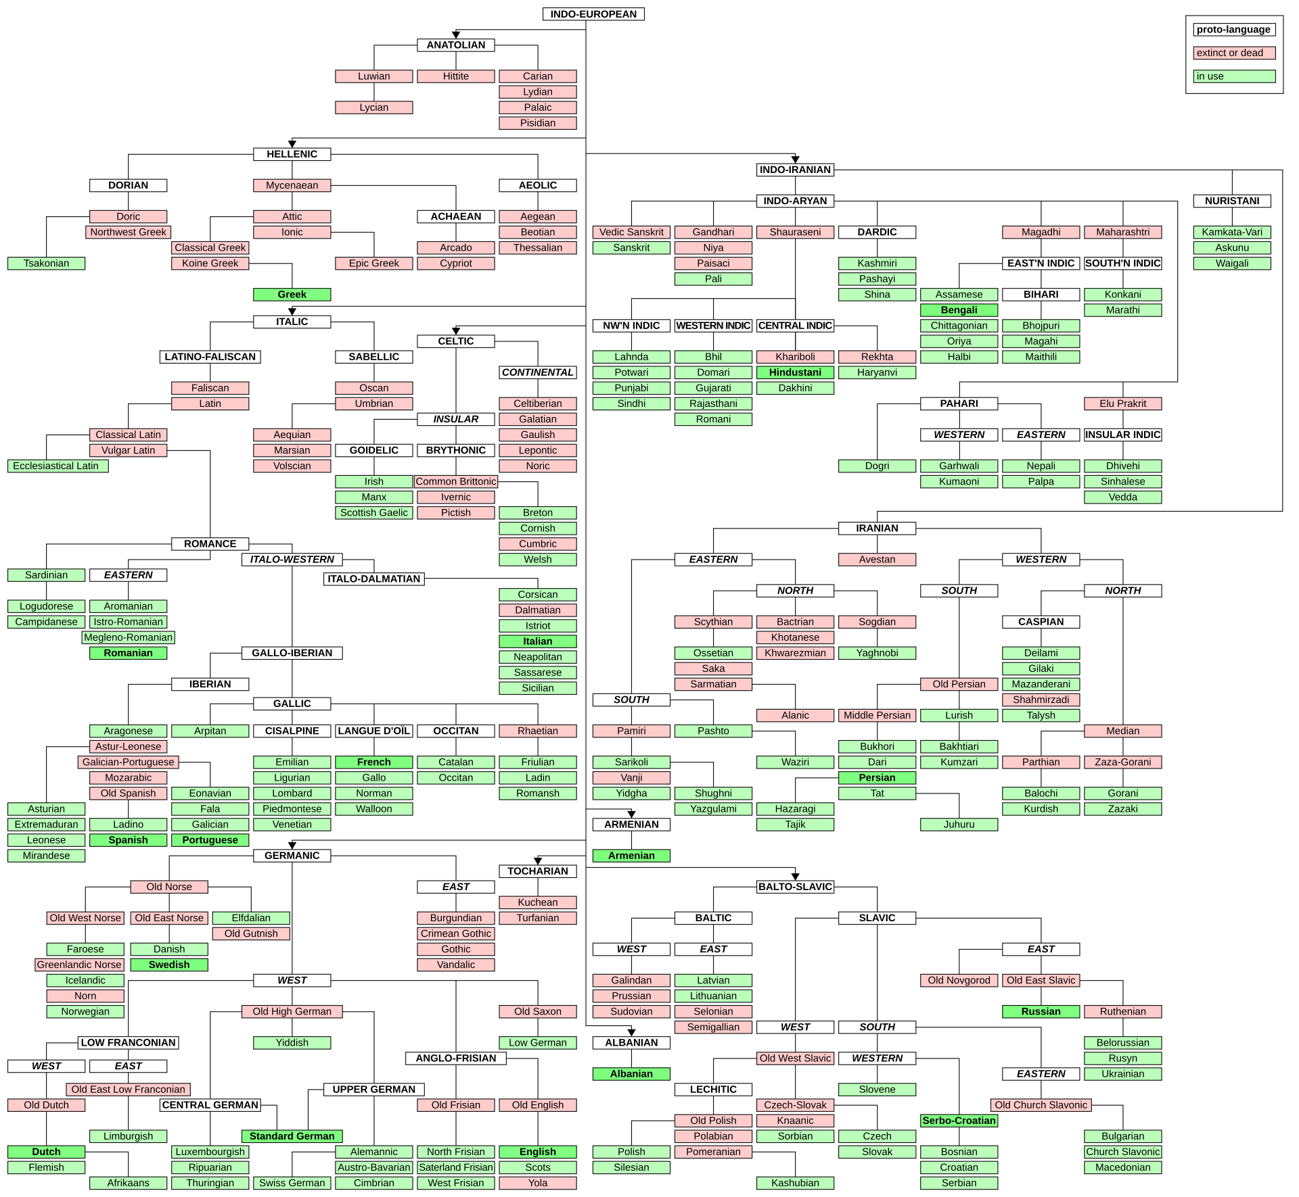
La Familia Indoeuropea

Slide 7
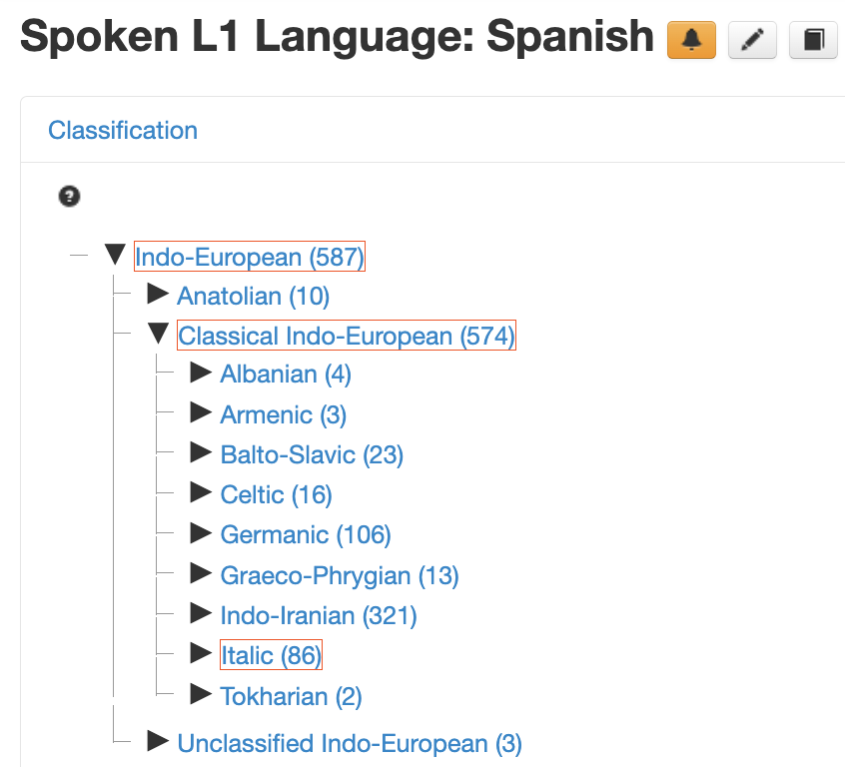
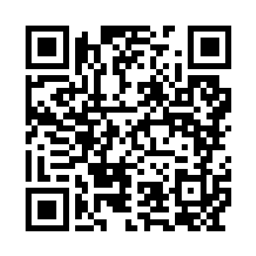
La Familia Indoeuropea
https://glottolog.org

Slide 8
La Familia Indoeuropea
Spanish and English look nothing alike.
But ~6,000 years ago, they were the same language.
Italic branch
Germanic branch
Latin → Spanish, French, Italian, Portuguese
Proto-Germanic → English, German, Dutch

Slide 9
Same Word, 6,000 Years Apart
These look completely different. They are the same word.
Spanish
English
PIE Root
ojo
eye
*okʷ-
noche
night
*nókʷts
corazón
heart
*ḱerd-
Not coincidences — the same word, separated by sound change over millennia.

Slide 10
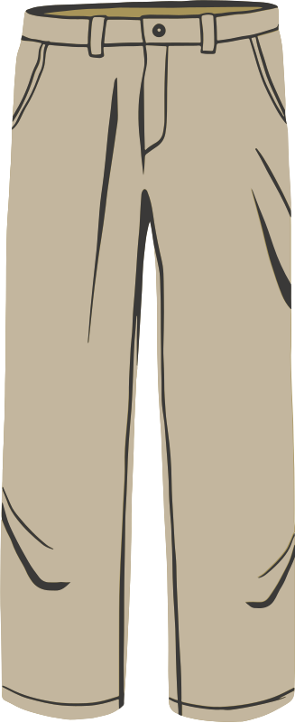
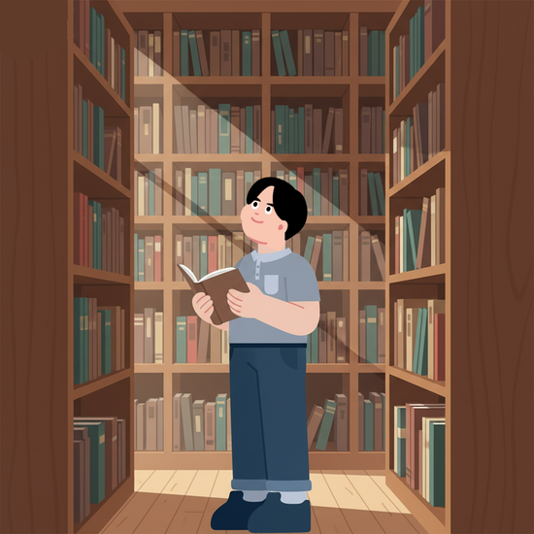

Phonetics: 1 Letter = 1 Sound
English 🇬🇧
Spanish 🇪🇸
through
pantalón
though
biblioteca
tough
fantasma
All end in '-ough'
All sound different
5 vowels — always the same.
Read it right the first time.

Slide 11
Two Ways to Say 'To Be'
English has one verb: to be. Spanish has two.
SER — identity / essence
ESTAR — state / condition
Soy doctor.
Estoy cansado.
I am a doctor.
I am tired (right now).
El cielo es azul.
El cielo está nublado.
The sky is blue.
The sky is cloudy (today).
Native speakers choose the right verb automatically — without thinking about it.

Slide 12
Pro-Drop: The Subject Is in the Verb
In English, you always need a subject pronoun. In Spanish, the verb already carries that information.
English
Spanish
I eat an apple.
Como una manzana.
She reads the book.
Lee el libro.
"Como" already means "I eat". Adding "Yo" (I) is optional — and a bit redundant.

Slide 13
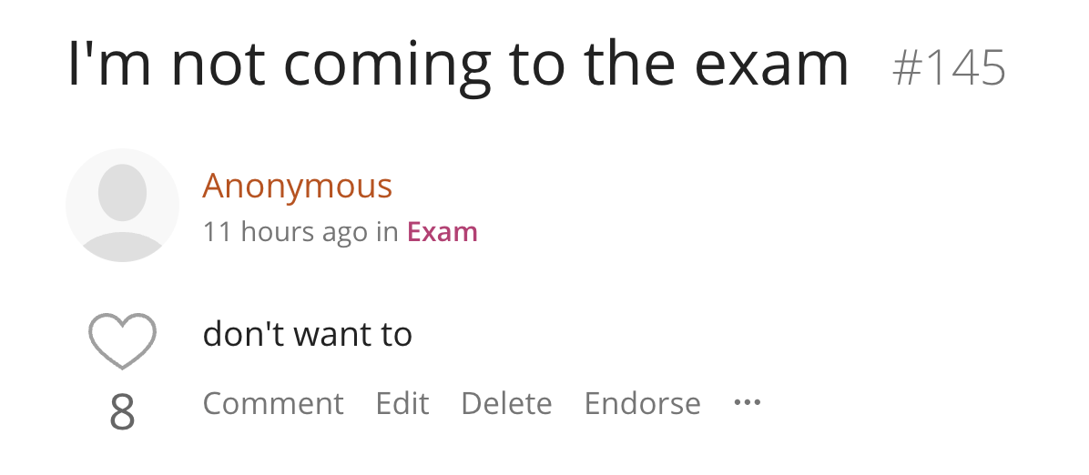
Pro-Drop: The Subject Is in the Verb
In everyday English, you sometimes also drop the pronoun.

Slide 14
The Arabic Layer
~4,000 Spanish words come from Arabic — legacy of 700 years of coexistence in the Iberian Peninsula.
El alcohol
←
al-kuḥl
→ "alcohol" in English too
El álgebra
←
al-jabr
→ "algebra" in English too
algoritmo
La almohada
←
al-mikhādda
→ "pillow" in English
ojalá

Slide 15
So… what is a language?
The US has more Spanish speakers than Spain.
9 out of 12 South American countries speak Spanish — the exceptions are Brazil, Guyana, and Suriname
Spain and Chilean Spanish: same language or different?

