Slide 1
Welcome to Urdu language
اردو زبان ميں خوش آمدید
FEIT Festival of Languages 2026
Syed Faraz Ahmed

Slide 2
Urdu اردو
Urdu is multi-cultural (Indo‑Aryan) language spoken by ~230 million people worldwide.
  30% of all Urdu speakers around the world are first language while 70% are second-language speakers.
10th-most widely spoken language in the world (The World Factbook)
Official language of Pakistan, widely used in India, and spoken across diaspora communities (including Australia).
Known for its expressiveness, soft phonetics, and deep link with poetry.

Slide 3
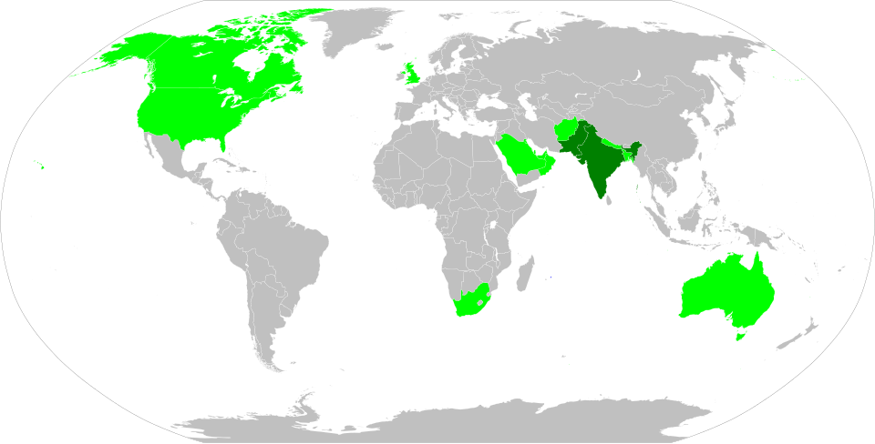
Notable Urdu speaking population

Slide 4
Global Distribution of Urdu Speakers
Country | Native Urdu Speakers | Year | Source
India | 50,772,631 | 2011 | [en.wikipedia.org]
Pakistan (first‑language speakers only) | 22,249,307 | 2023 | [en.wikipedia.org]
United States | 397,502 | 2013 | [en.wikipedia.org]
Bangladesh | 300,000 | 2011 | [en.wikipedia.org]
United Kingdom | 270,000 | 2011 | [en.wikipedia.org]
Canada | 210,815 | 2016 | [en.wikipedia.org]
Nepal | 413,785 | 2021 | [en.wikipedia.org]
Australia | 69,131 | 2016 | [en.wikipedia.org]
Afghanistan | 823,000 | 2024 | [worldpopul...review.com]
Saudi Arabia | 728,000 | 2024 | [worldpopul...review.com]
United Arab Emirates | 113,000 | 2024 | [worldpopul...review.com]

Slide 5
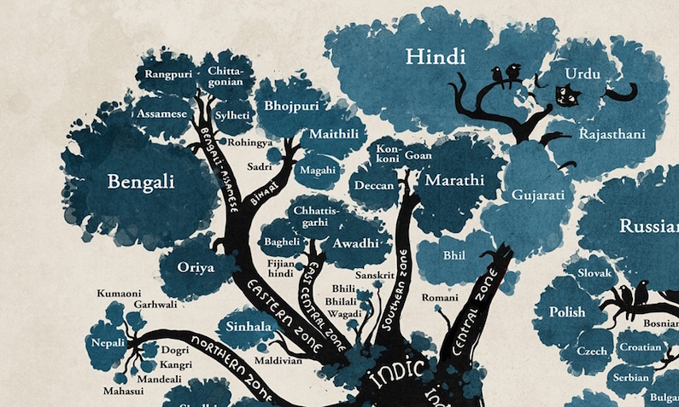
Urdu اردو
A language born of cultural fusion
  Emerged around the 12th century in northern India.
  Developed in the Mughal courts—mixing:
    Indic languages (like Hindi’s early forms)
    Persian
    Arabic
    Turkic languages
      The word Urdu itself means “camp/army”, reflecting its multicultural origin.
https://www.zabaan.com/blog/a-short-history-of-the-urdu-language/

Slide 6
Dialects of Urdu
Dialect | Region | Key Features
Standard Urdu | Pakistan, India, global | Formal, media, education
Dakhni | South India | Local vocabulary (Telugu/Marathi), melodic tone
Rekhta | Historic | Classical poetry, Persian-heavy
Lucknowi Urdu | Lucknow | Polite, elegant language
Karachi Urdu | Karachi | Fast, urban, English mix
Punjabi-Urdu | Punjab (Pak.) | Punjabi intonation
Pahari Urdu | Kashmir/North | Soft, mixed vocabulary
Diaspora Urdu | Middle East, UK, etc. | Arabic/English code-switching

Slide 7
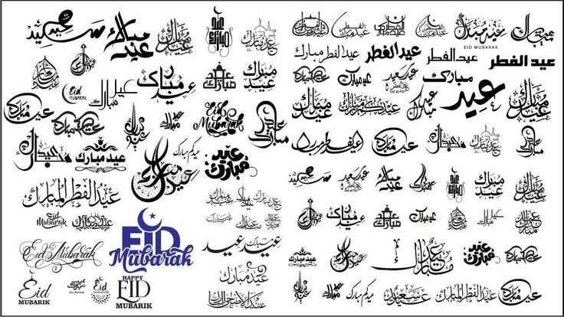
Urdu writing
Written in a Perso‑Arabic script, flowing right → left.
Uses a cursive, calligraphic style (Nastaliq).
  Each letter changes shape depending on its position in a word.
  Fun fact: Urdu is considered one of the most beautiful scripts and is central to South Asian calligraphy.
Persian & Arabic Influence
  Core vocabulary, idioms, literary expressions, and abstract concepts often come from:
    Persian (e.g., zindagi—life, khubsoorat—beautiful)
    Arabic (e.g., ilm—knowledge, insaan—human)

Slide 8
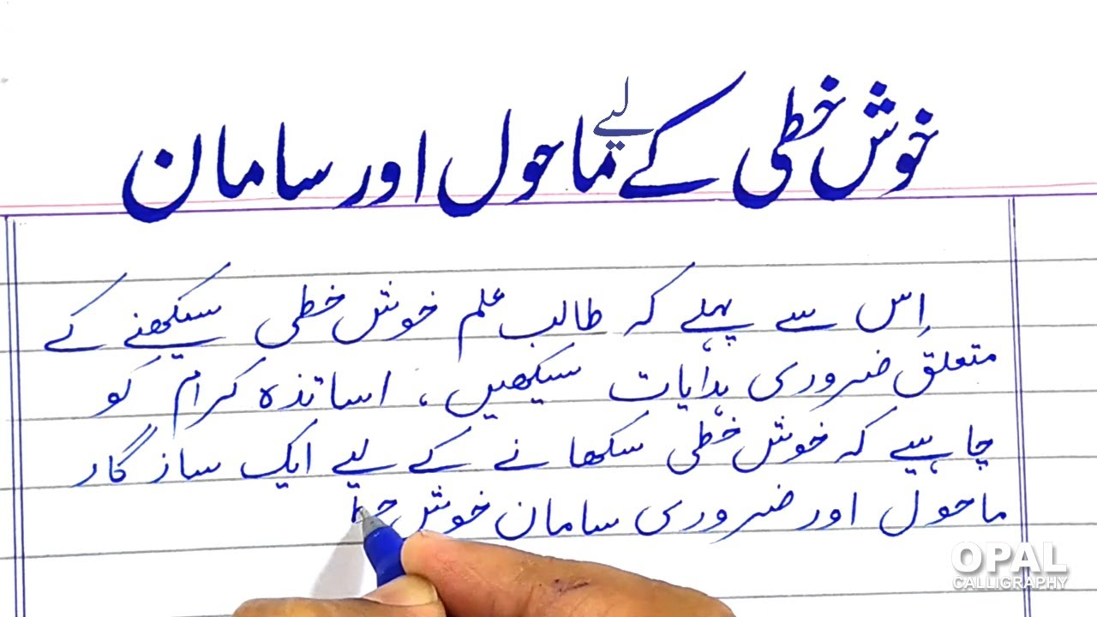
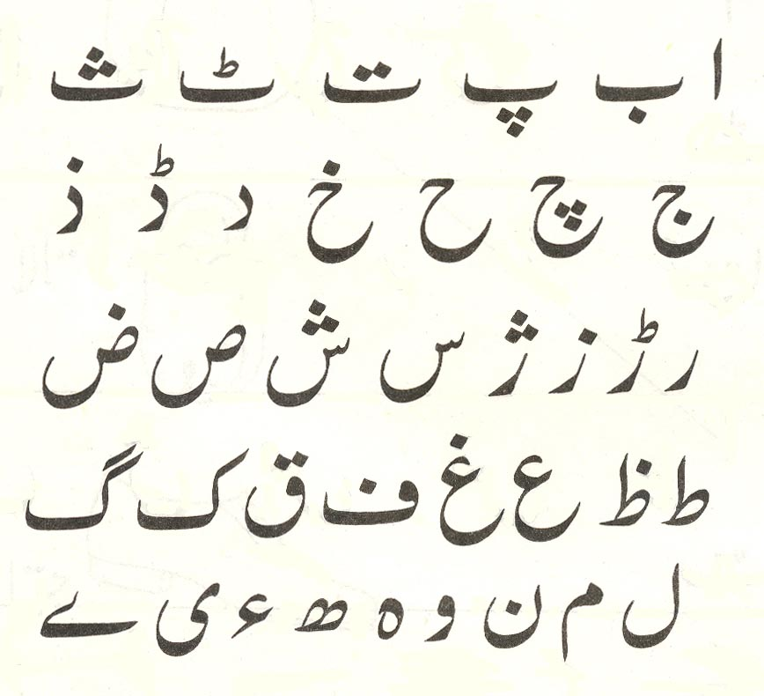
Urdu writing
خ + و + ش = خوش
پ + ہ + ل + ے = پہلے

Slide 9
Urdu language and diversity
A Language Born From Diversity
Urdu itself emerged as a blend of Indic, Turkic, Persian, and Arabic elements.
Because it originated in multicultural contact zones, absorbing vocabulary is built into its DNA.
A Natural Borrower
Urdu freely incorporates words from different languages without resistance.
Borrowed words often blend seamlessly into everyday usage—sometimes to the point people forget their foreign origin.

Slide 10
Urdu and Hindi
Spoken Urdu and Hindi are mutually intelligible in everyday conversation.
Differences arise in:
Vocabulary: Urdu draws more from Persian/Arabic; Hindi from Sanskrit.
Script: Urdu uses Perso‑Arabic; Hindi uses Devanagari.
Analogy: Something like British vs. American English—but with different scripts

Slide 11

Urdu and English
Similarities.
Both have subject–verb–object word order (although Urdu allows flexibility).
Both borrow words from other languages.
Differences
Direction:
Urdu is written right → left; English is left → right.
Gendered nouns:
English has few gendered words; in Urdu every noun has a gender.
Politeness levels:
English is mostly neutral; Urdu has built-in politeness tiers (e.g., tu, tum, aap for “you”). Tenses & verb endings are more flexible and expressive in Urdu.
Many English words originate (indirectly) from Urdu/Hindi:
shampoo, pajamas, jungle, bungalow, thug, bandana, cheetah.
Notes:
Urdu embeds politeness into the grammar itself:
tu — very informal (intimate or rude depending on context)
tum — casual, friendly
aap — formal, respectful

Slide 12
Urdu and English
Urdu contains several consonants that English speakers rarely produce, such as: ق ( qāf) — a deep, throaty Q sound غ ( ghain) — a voiced gargled GH خ ( kha) — a soft, airy KH, like the ch in “Bach” ڑ ( ṛe) — a retroflex R (sounds like “R” + “D” combined)
Notes:
Urdu verbs encode:
Subject gender
Subject number
Tense
Aspect
Politeness level
Example:
"Aap jaa rahe the" implicitly contains: you (formal) + going + masculine plural + past continuous.

Slide 13
Modern English Influence
  Contemporary Urdu absorbs English words constantly, especially in:
    Technology: computer, file, laptop
    Business: office, manager, project
    Everyday conversation: phone, train, market
    Many speakers code-switch between the two languages effortlessly.
      English “school” → اسکول
    Fun fact: In modern metropolitan Urdu, entire sentences are often a hybrid like:
      "ميٹنگ ریشیجول کردیں"
      “Meeting reschedule kar dein?” (“Can we reschedule the meeting?”)

Slide 14
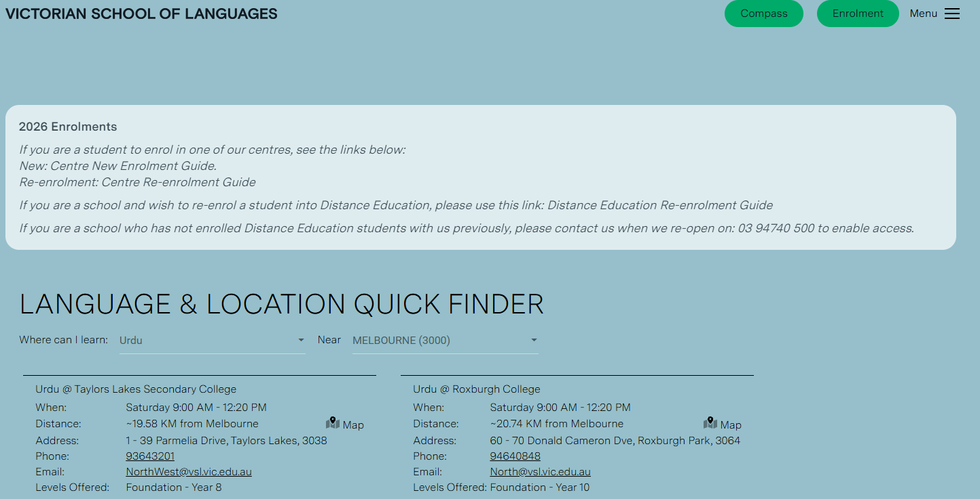
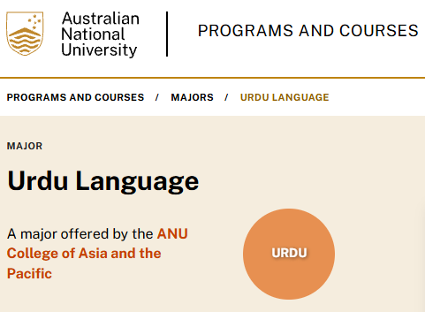
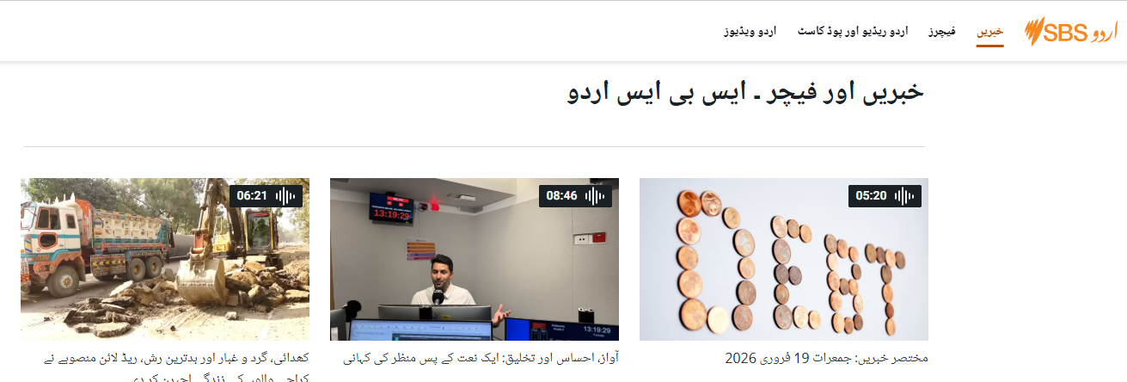
Learning Urdu in Australia
https://web.vsl.vic.edu.au/language-finder/
https://www.sbs.com.au/language/urdu/ur/collection/news-and-features-in-urdu

Slide 15
Thank you!
Urdu reminds us that when cultures meet, something beautiful is born.
Thank you for celebrating diversity with us.
Together, we grow stronger.”
شکریہ
Shuk-riyah

